Slide 1
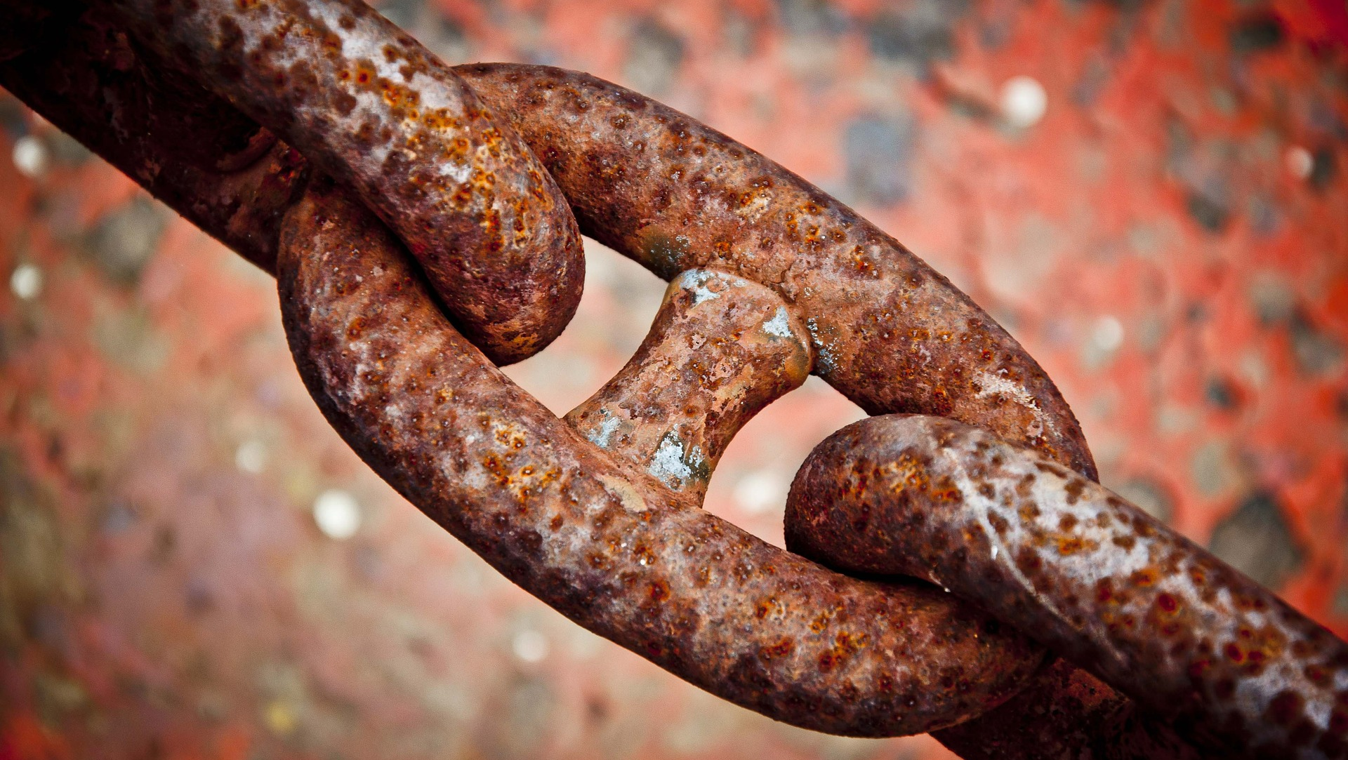
Building a Secure, Automated Supply Chain
https://andyc.info/dnf19

Slide 2
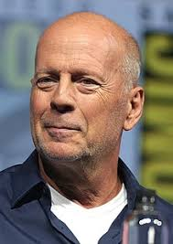

What is NOT a Secure Supply Chain?
Don’t be Bruce!

Slide 3
What is a Secure Supply Chain?
Known good source / Source of Truth
Known good path / Chain of Custody
CVE Scanning
Repeatability and Automation
Cryptographic Assurance

Slide 4
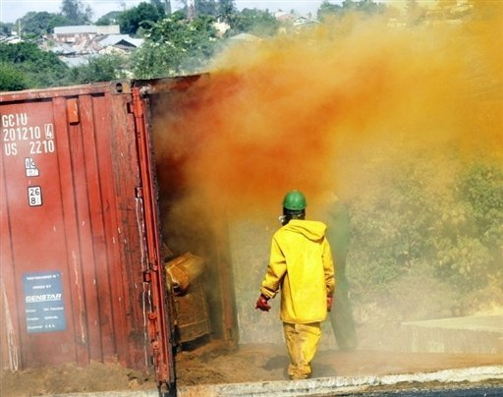
Container Fire?

Slide 5
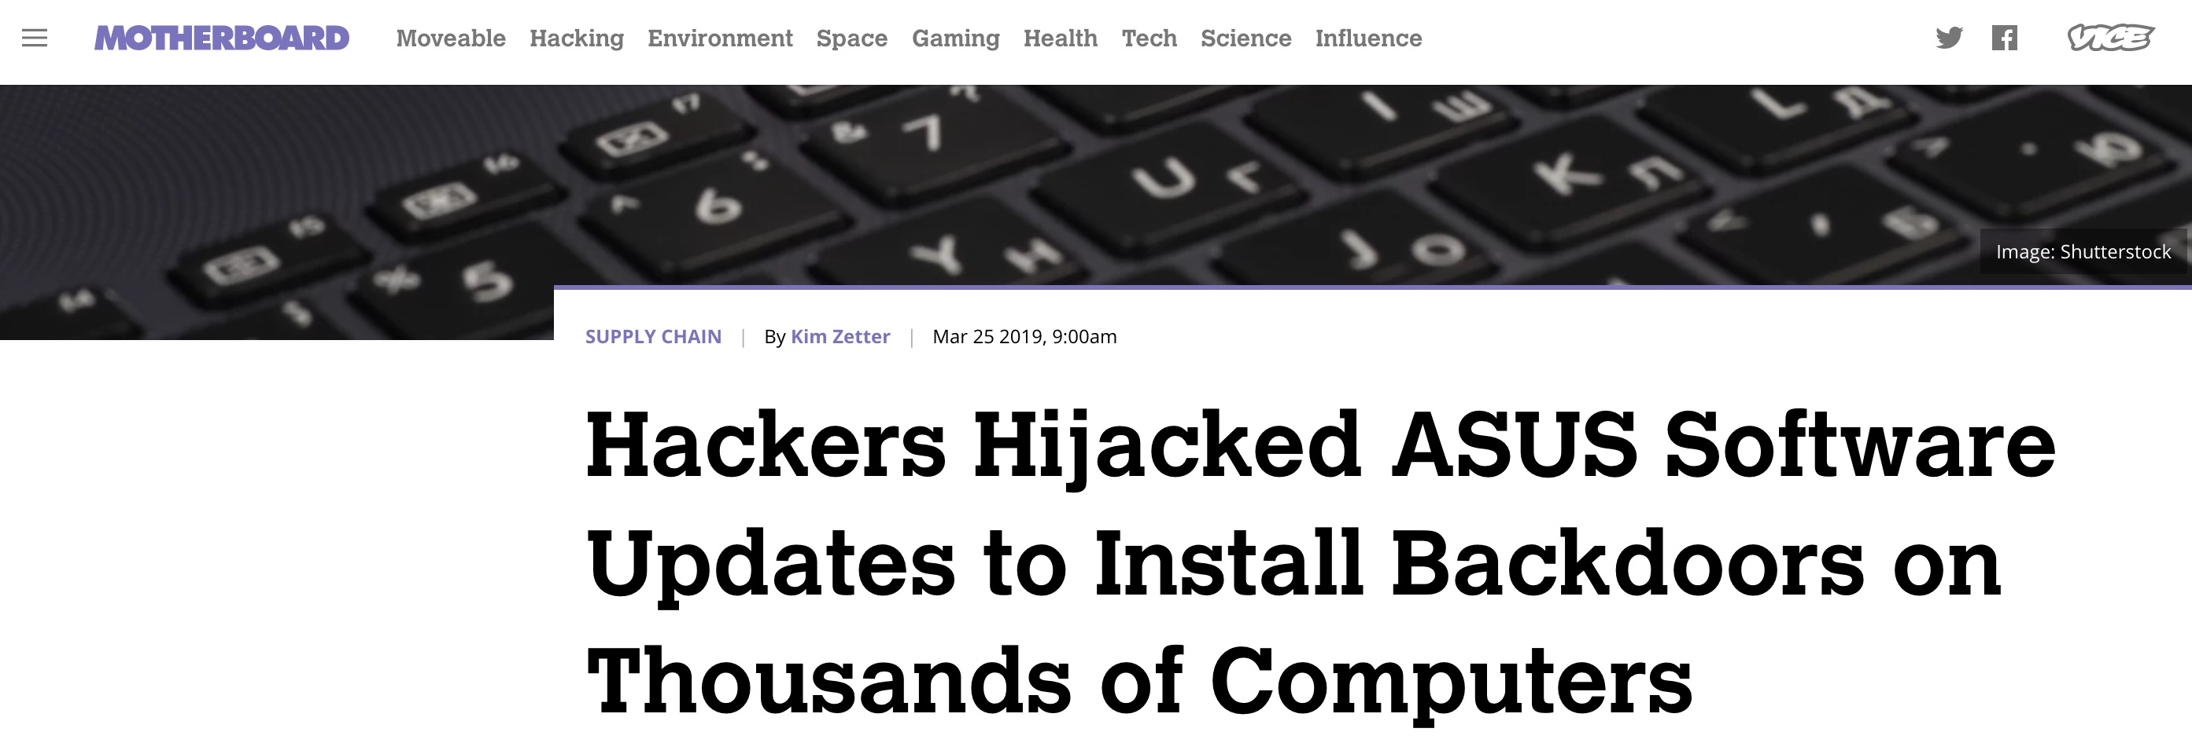
Honestly Why?

Slide 6
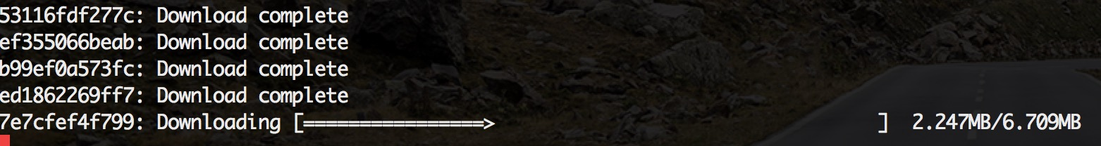
Man in the Middle?
Docker pull from 35k feet!

Slide 7
Replay Attack?

Slide 8
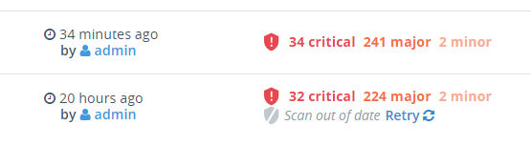
Vulnerabilities?

Slide 9
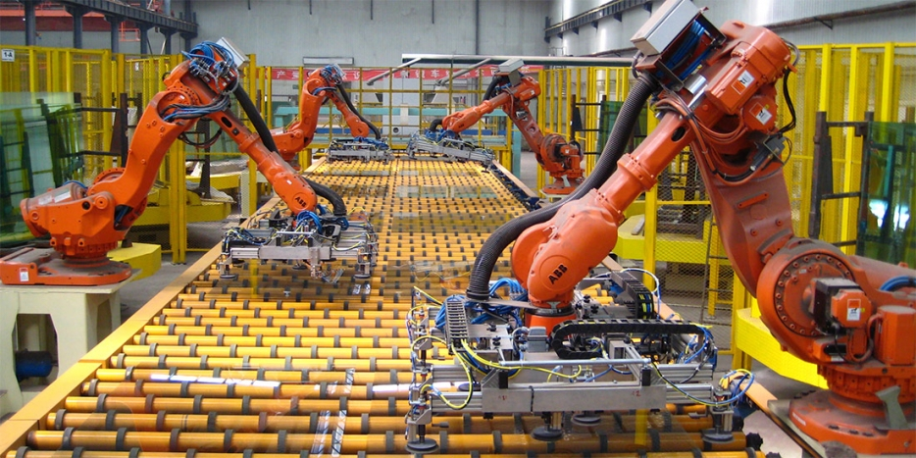

Automation = Repeatability

Slide 10
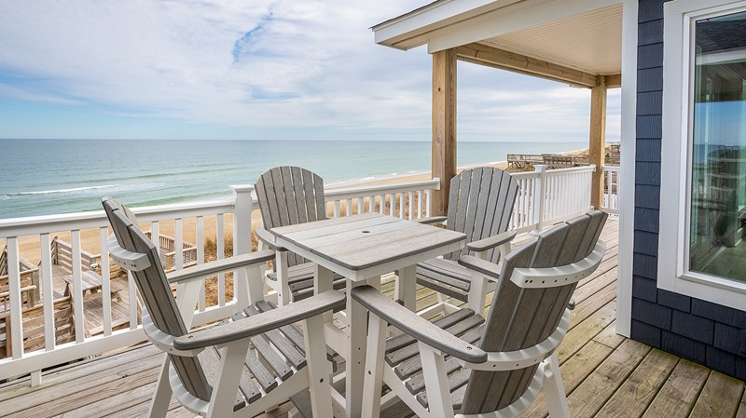
Automation = Vacations!

Slide 11
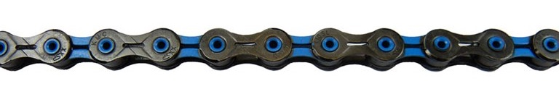
Chain of Custody?

Slide 12
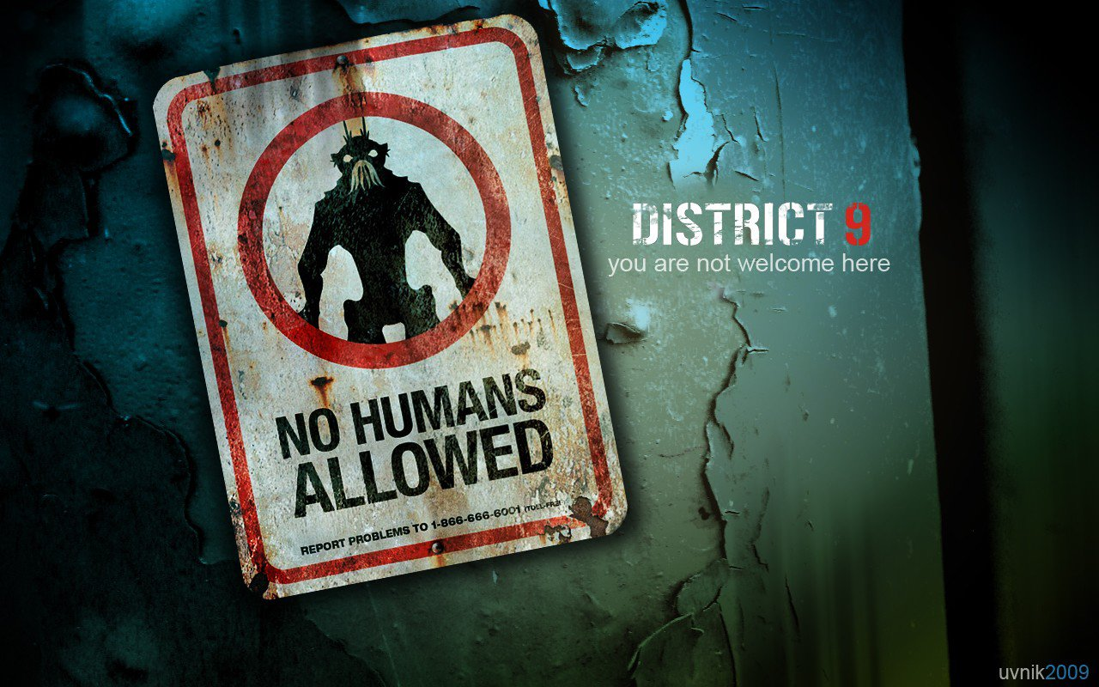
Image credit: https://www.deviantart.com/uvnik/art/No-humans-allowed-142046016
“No human should EVER build or deploy code meant for production!”
Image credit: https://www.deviantart.com/uvnik/art/No-humans-allowed-142046016

Slide 13

We can do this…
Known good source / Source of truth
Known good path / Chain of Custody
CVE Scanning
Repeatability and Automation
Cryptographic Assurance

Slide 14
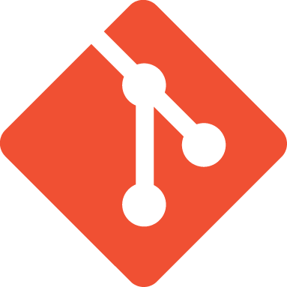

Two Known Good Starting Points
Code
Images

Slide 15

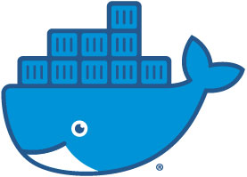
Fundamental Path
Docker Trusted
Registry
Docker push
git commit
build number
tag

Slide 16

With Cryptographic Assurance
Docker Trusted
Registry
Docker push
git commit
build number
tag

Slide 17
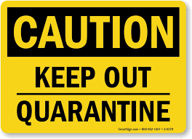
Quarantine?
Quarantine
Non-Prod
Docker Trusted
Registry
Docker Trusted
Registry

Slide 18
Spoke and Hub?
Prod - Cloud
Docker Trusted
Registry
Non-Prod
Docker Trusted
Registry
Prod - OnPrem
Docker Trusted
Registry

Slide 19

We GOT THIS…
Known good source / Source of truth
Known good path / Chain of Custody
CVE Scanning
Repeatability and Automation
Cryptographic Assurance

Slide 20
Don’t be Bruce!
https://andyc.info/dnf19

